Slide 1
Psalm 23 (NIV)
1 The Lord is my shepherd, I shall not be in want.
2 He makes me lie down in green pastures, he leads me beside quiet waters,
3 he restores my soul. He guides me in paths of righteousness for his name's sake.
4 Even though I walk through the valley of the shadow of death, I will fear no evil, for you are with me; your rod and your staff, they comfort me.

Slide 2
Psalm 23 (NIV)
5 You prepare a table before me in the presence of my enemies. You anoint my head with oil; my cup overflows.
6 Surely goodness and love will follow me all the days of my life, and I will dwell in the house of the Lord forever.

Slide 4
Practices of Faith
Giving –
Kay Brown

Slide 5
Practices of Faith - Giving
Psalm 23
The Lord is my Shepherd
I shall not want

Slide 6
Practices of Faith - Giving
Psalm 23 God’s gifts to us
I shall not want
v2 Rest
Water

Slide 7
Practices of Faith - Giving
Psalm 23 God’s gifts to us
I shall not want
v3 Forgiveness
Guidance

Slide 8
Practices of Faith - Giving
Psalm 23 God’s gifts to us
I shall not want
v4 Companionship
Comfort

Slide 9
Practices of Faith - Giving
Psalm 23 God’s gifts to us
I shall not want
v5 Food
Joy
Overflowing blessings

Slide 10
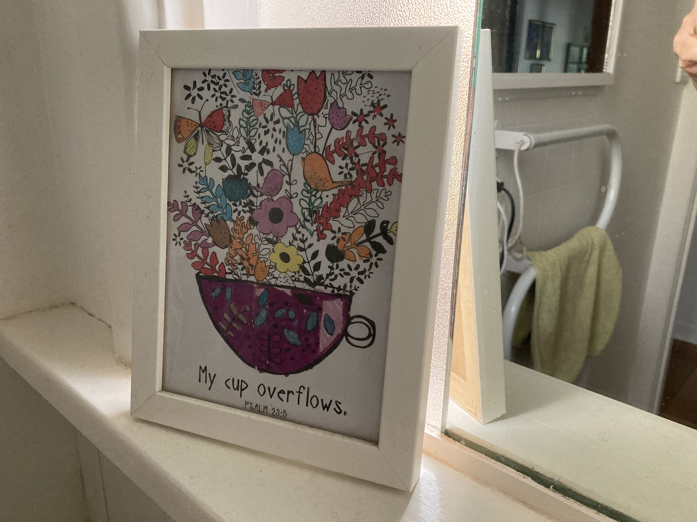
Practices of Faith - Giving
Psalm 23 God’s gifts to us
I shall not want
v5 Food
Joy
Overflowing blessings

Slide 11
Practices of Faith - Giving
Psalm 23 God’s gifts to us
I shall not want
v6 Goodness and love
Eternity with God

Slide 12
Practices of Faith - Giving
Psalm 23 God’s gifts to us
V1 I shall not want
V2 Rest
Jesus words to us
Matthew 11:28
Come to me, all
you who are weary
and burdened, and I will give you rest

Slide 13
Practices of Faith - Giving
Psalm 23 God’s gifts to us
V1 I shall not want
V2 Water
Jesus words to us
John 7:37
If anyone is thirsty,
let him come to me and drink.

Slide 14
Practices of Faith - Giving
Psalm 23 God’s gifts to us
V3 Forgiveness
Jesus words to us
Mark 2:10
the Son of Man has authority on earth to forgive sins

Slide 15
Practices of Faith - Giving
Psalm 23 God’s gifts to us
V3 Guidance
Jesus words to us
John 16:13
But when he, the Spirit of truth, comes, he will guide you into all truth.

Slide 16
Practices of Faith - Giving
Psalm 23 God’s gifts to us
V4 Companionship
Jesus words to us
Matthew 28:20
And surely I am with you always, to the
very end of the age.

Slide 17
Practices of Faith - Giving
Psalm 23 God’s gifts to us
V4 Comfort
Jesus words to us
John 16:7
It is for your good that I am going away. Unless I go away, the Counsellor will not come to you.

Slide 18
Practices of Faith - Giving
Psalm 23 God’s gifts to us
V5 Food
Jesus words to us
John 6:35
I am the bread of life.
He who comes to me will never go hungry

Slide 19
Practices of Faith - Giving
Psalm 23 God’s gifts to us
V5 Joy
Jesus words to us
John 16:24
Ask and you will receive, and your joy will be complete

Slide 20
Practices of Faith - Giving
Psalm 23 God’s gifts to us
V5 Overflowing
blessings
Jesus words to us
John 14:13
And I will do whatever you ask in my name,
so that the Son may
bring glory to the
Father

Slide 21
Practices of Faith - Giving
Psalm 23 God’s gifts to us
V6 Goodness and love
Jesus words to us
Matthew 6:33
But seek first his kingdom and his righteousness,
and all these things will be given to you as well.

Slide 22
Practices of Faith - Giving
Psalm 23 God’s gifts to us
V6 Eternity
with God
Jesus words to us
John 14:2
In my Father’s house are many rooms; if it were
not so, I would have told
you. I am going there to prepare a
place for you.

Slide 23
Practices of Faith – Giving 2 Corinthians 8:7-9
… see that you also excel in this grace of giving.
I am not commanding you, but I want to test the sincerity of your love by comparing it with the earnestness of others.
For you know the grace of our Lord Jesus Christ, that though he was rich, yet for your sakes he became poor, so that you through his poverty might become rich.

Slide 24
Practices of Faith – Giving 2 Corinthians 8:7-9
… see that you also excel in this grace of giving.
I am not commanding you, but I want to test the sincerity of your love by comparing it with the earnestness of others.
For you know the grace of our Lord Jesus Christ, that though he was rich, yet for your sakes he became poor, so that you through his poverty might become rich.

Slide 25
Practices of Faith – Giving generously

Slide 26
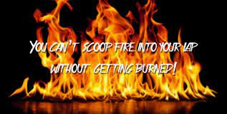
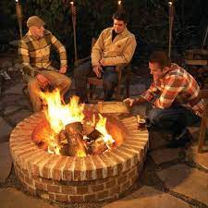
Practices of Faith – Giving generously

Slide 27
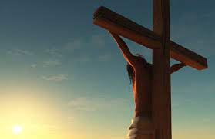
Practices of Faith – Giving generously
For you know the grace of our Lord Jesus Christ, that though he was rich, yet for your sakes he became poor, so that you through his poverty might become rich.

